Slide 1

Toronto Crime Investigation
Shahmeer Amjad
Punam Sonawane
Nitin Madaan
Ruolan Fan

Slide 2
#Agenda
Mission
1.Mission Statement
2.Social Media Analysis
Data
Data Sources
Data Exploration & Cleanup Process
Analysis
Detailed Analysis
Questions to consider
Wrap Up
Key Takeaways
Lessons Learned
Q&A Session

Slide 3
Mission

Slide 4

Mission Statement
We aimed to analyze real world data in order to :-
Gain a better understanding of crime incidents in the city of Toronto
To identify patterns, and specific neighborhoods where crime rates were higher
Attain a holistic overview of Toronto’s crime landscape based on geographic locations

Slide 5

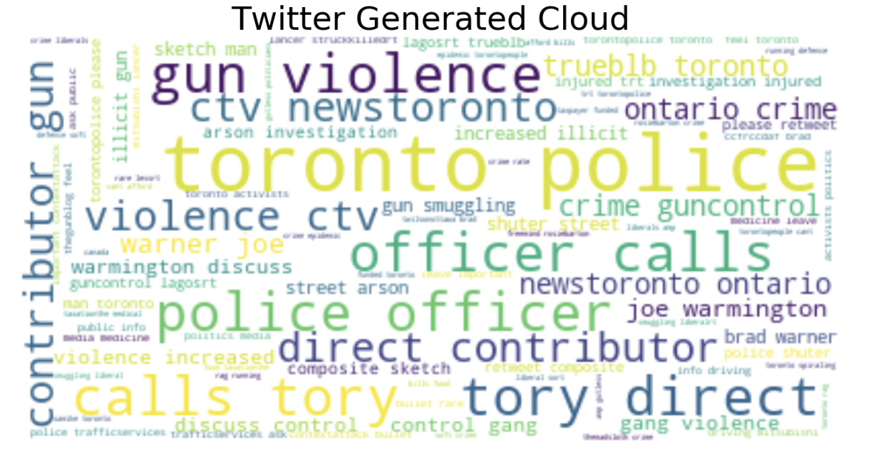
Social Media Analysis

Slide 6
Data

Slide 7




Data Sources

Slide 8

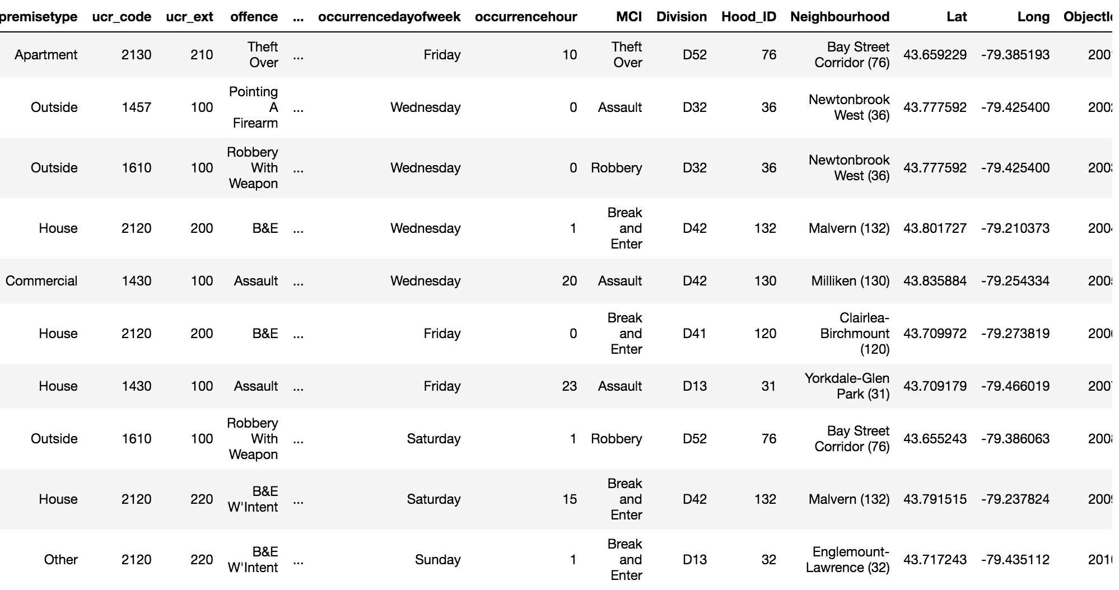
Primary Dataset: Crime

Slide 9
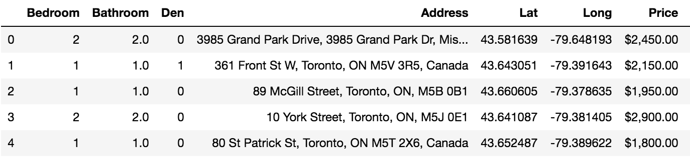
Secondary Dataset: Rental Dataset

Slide 10
Data Clean Up Process
Obtained Crime dataset from Kaggle
Formatted Rental price to change format of Pricing Variable
Removed ‘$’ and “,” from Column and changed from String to Integer
Removed outliers where ‘Price’ was less than $300
Obtained relevant tweets using Twitter API { #Toronto && #Crime}
Gathered a sample size of over 1000 tweets
Cleaned tweets using various packages and extracted a single keyword to create a word cloud

Slide 11
Analysis

Slide 12
Q. What type of incidents happen more frequently in the city of Toronto?

Slide 13
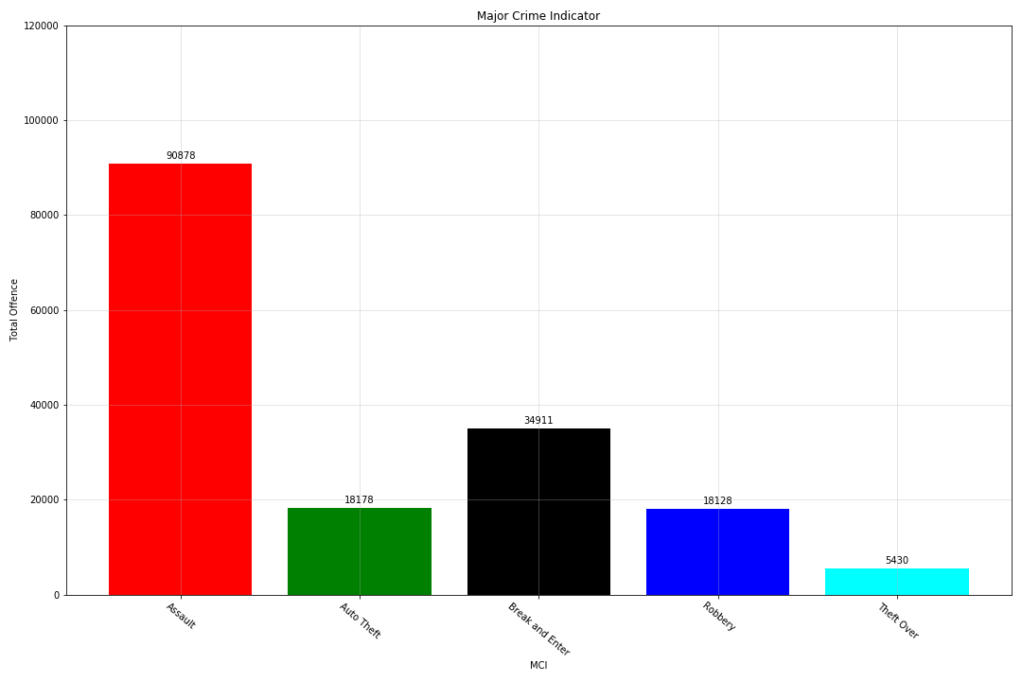
Result

Slide 14
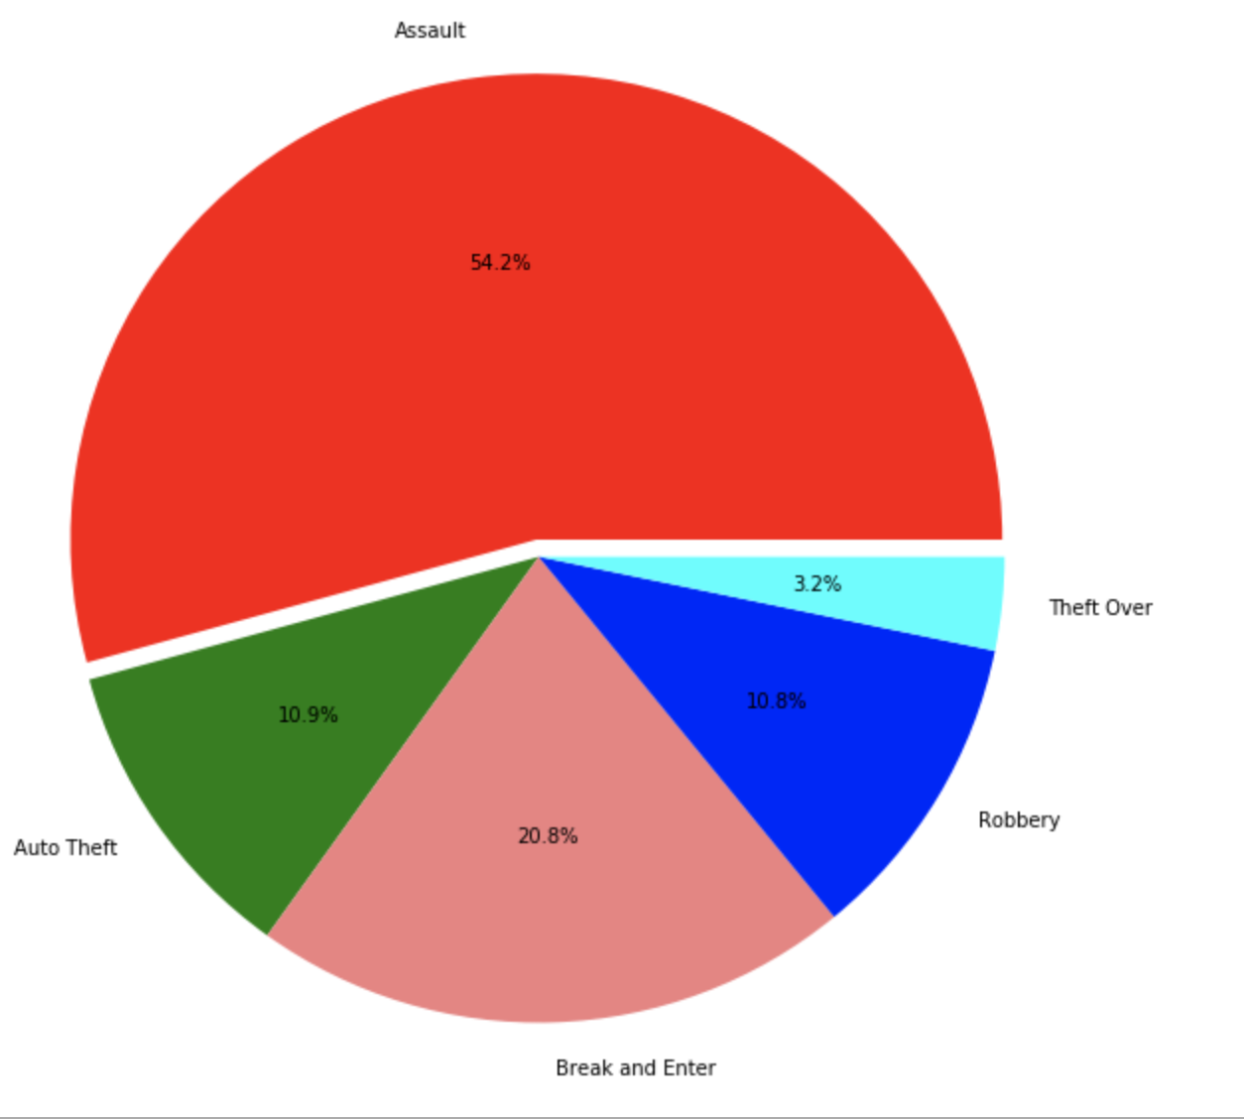
Result
Legend
Assault
Break and Enter
Auto Theft
Robbery
Theft Over

Slide 15
Q. Do these crimes have a specific pattern?
{Yearly,
Monthly,
Seasonally,
Weekday Vs Weekend,
Hourly?}

Slide 16
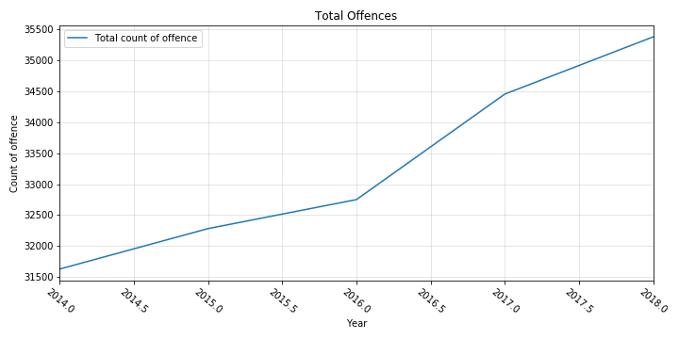
#Yearly Trend
Result

Slide 17
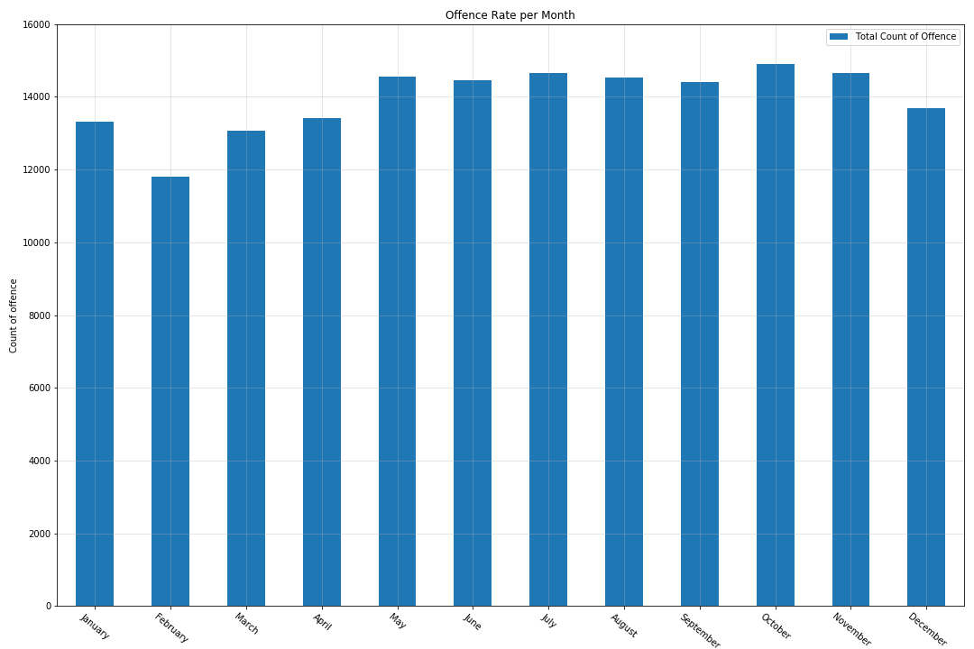
#Monthly Trend
Result

Slide 18
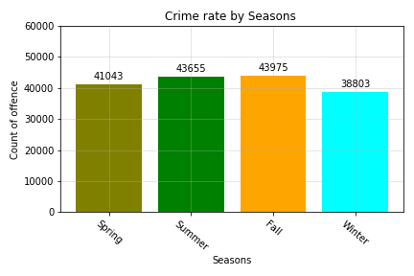
#Seasonal Trend
Result

Slide 19
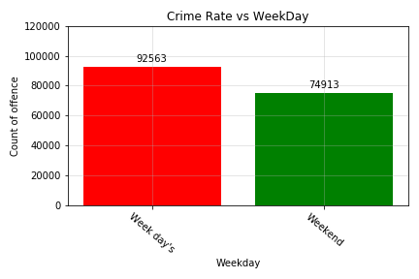
#Weekday Vs Weekends
Result

Slide 20
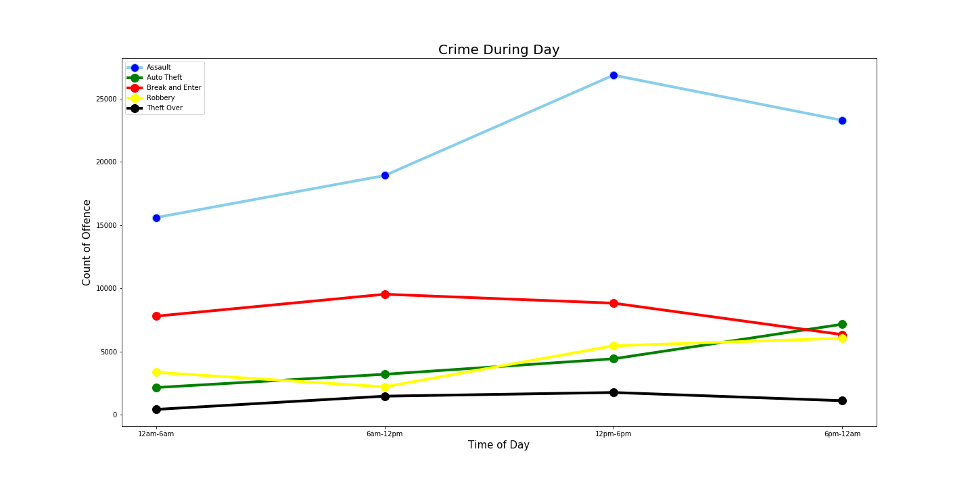
#Hourly Trend for each Incident Type
Result

Slide 21
Q. Is there a relationship b/w Occurrence Day && Occurrence Hour?

Slide 22
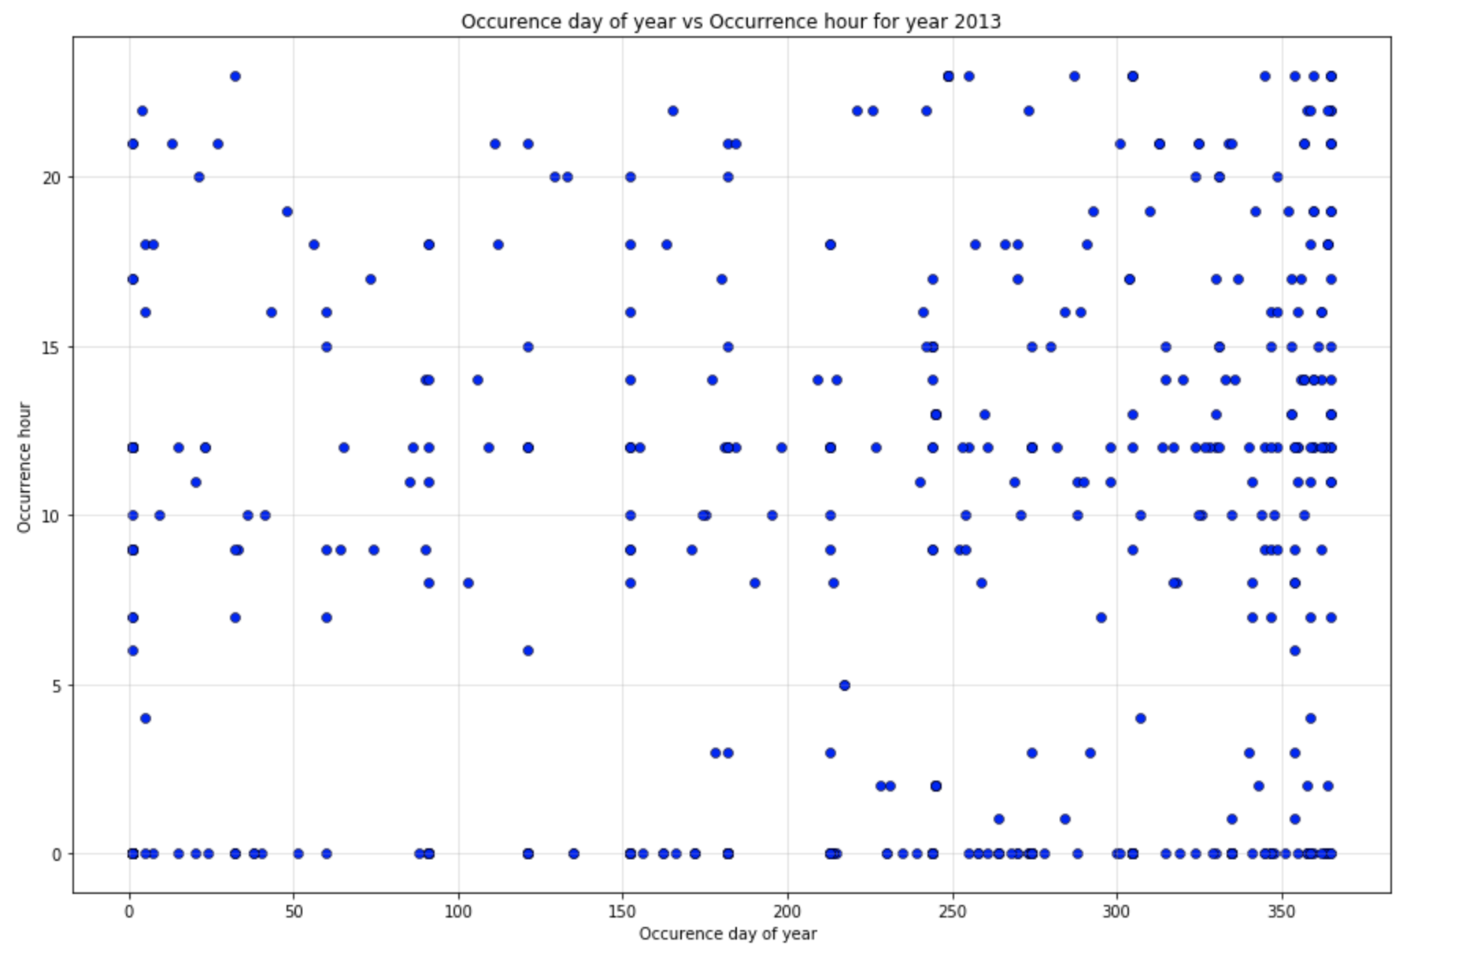
#ScatterPlot {2013}
Result

Slide 23
Q. Which Neighborhoods(Top5) are the safest && which are the most unsafe? {Only in 2018}

Slide 24
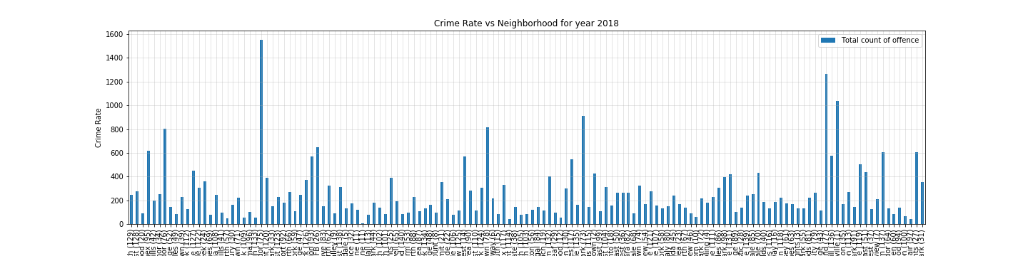
#Crime by Neighborhood
Result

Slide 25
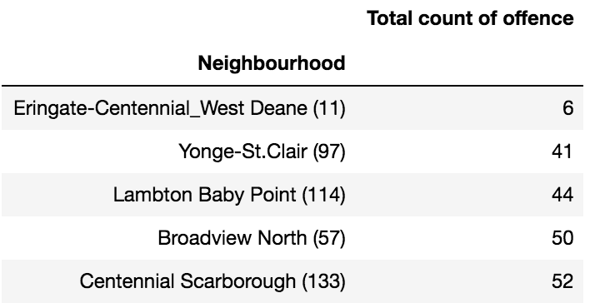
#Safest Areas
Result

Slide 26
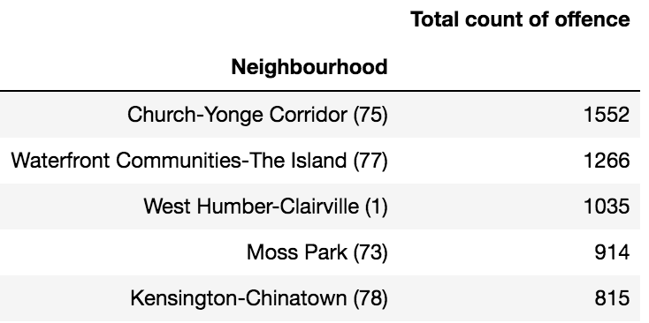
#Most Unsafe Areas
Result

Slide 27
Q. Do Lower-Rent Neighborhoods have more crime incidents Vs Relatively expensive areas?

Slide 28
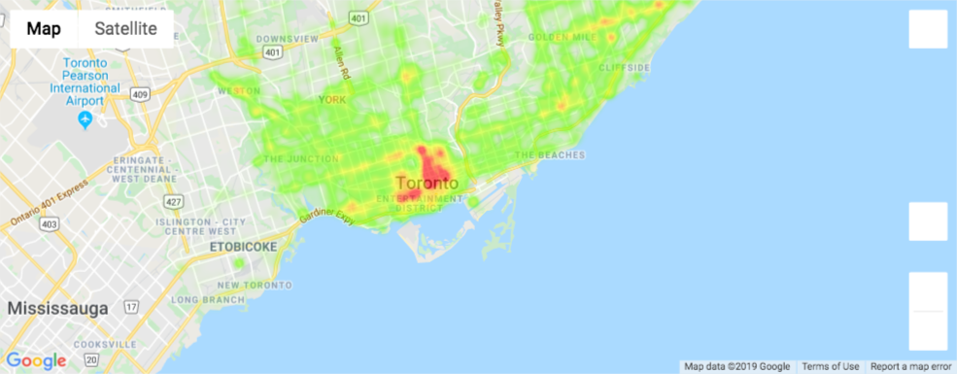
#Heat Map of Incidents
Result
Zoom level=11

Slide 29
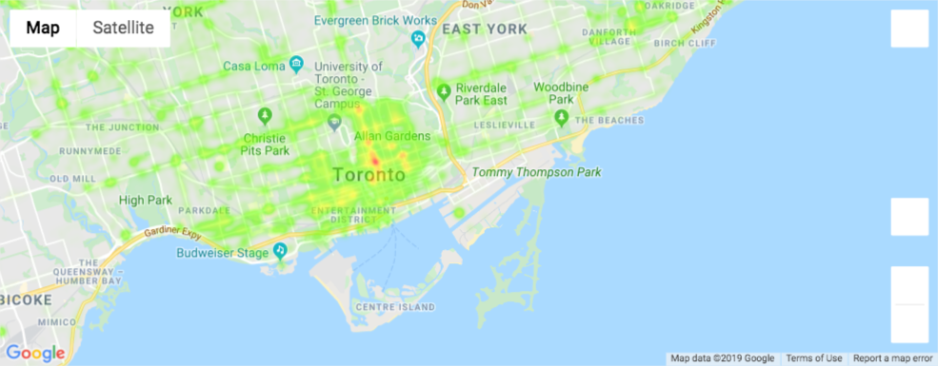
#Heat Map of Incidents
Result
Zoom level=12

Slide 30
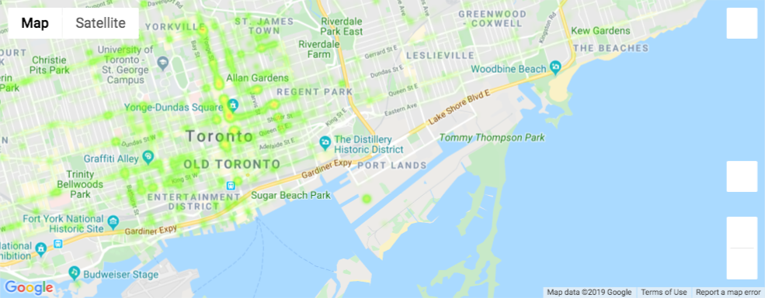
#Heat Map of Incidents
Result
Zoom level=13

Slide 31
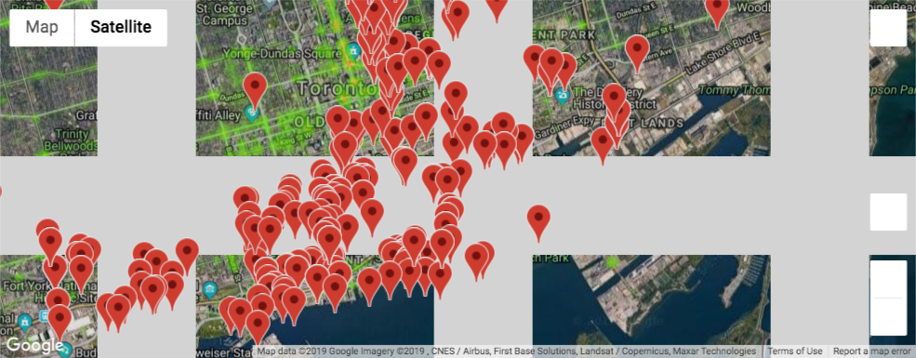
#Heat Map + Rental Apts(Price{2000-3000})
Result
Zoom level=13.5

Slide 32
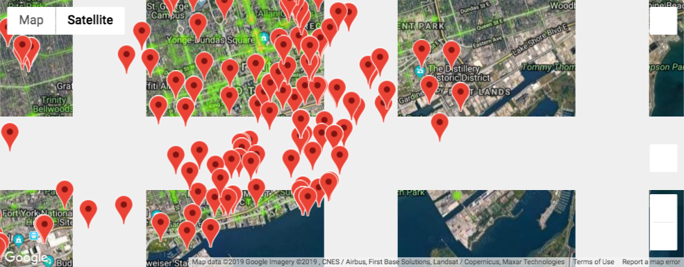
#Heat Map + Rental Apts(Price{<2000})
Result
Zoom level=13.5

Slide 33
Wrap-up

Slide 34
Key Takeaways
In Toronto ‘Assault’(54.2%) and ‘Breaking and Entering’ (20.8%)are the most common crimes
Overall, crime has been on the rise and has consistently increased over the years!
No significant Monthly/Seasonal Pattern noted
Incidents are more likely to occur on Weekdays Vs Weekends
Relatively more incidents occurred between 12pm-6pm vs in the evenings!
Relatively no significant relationship b/w occurence day and occurrence year, might require further investigation
Identified Top 5 safest areas and top 5 Unsafest areas
Based on heatmap more incidents occurred in a specific area
No significant relationship b/w Toronto property rental prices & Crime Data, might require further investigation

Slide 35
Lessons Learned
Data may be messy
Real-life data may not always be in well-structured CSVs
Follow your data-intuition
Don’t be afraid of trying something...you might get errors in the process but you have many many resources online to refer to
Keep well structured and documented code
Having well-documented codes with comments ensure that you (and others) understand it when you revisit your approaches later
Consistent Variable naming conventions
Avoid making vague variables to reduce misunderstandings
Coordination && cooperation is essential!
Especially with many developers and while using Git {to avoid data loss}
Every API interacts differently
reading and understanding API documentation is KEY

Slide 36
Q&A

Slide 37


